Slide 1
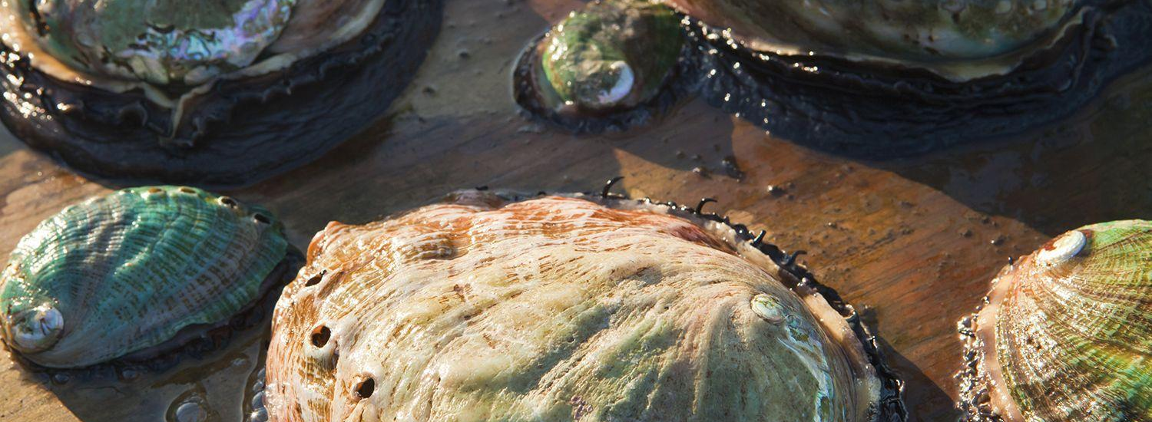
Age of Abalone Prediction
Department of Primary Industry and Fisheries of Tasmania
Amanda Gregory - Claire Xiao - Jason Qi - Yves Esslinger

Slide 2
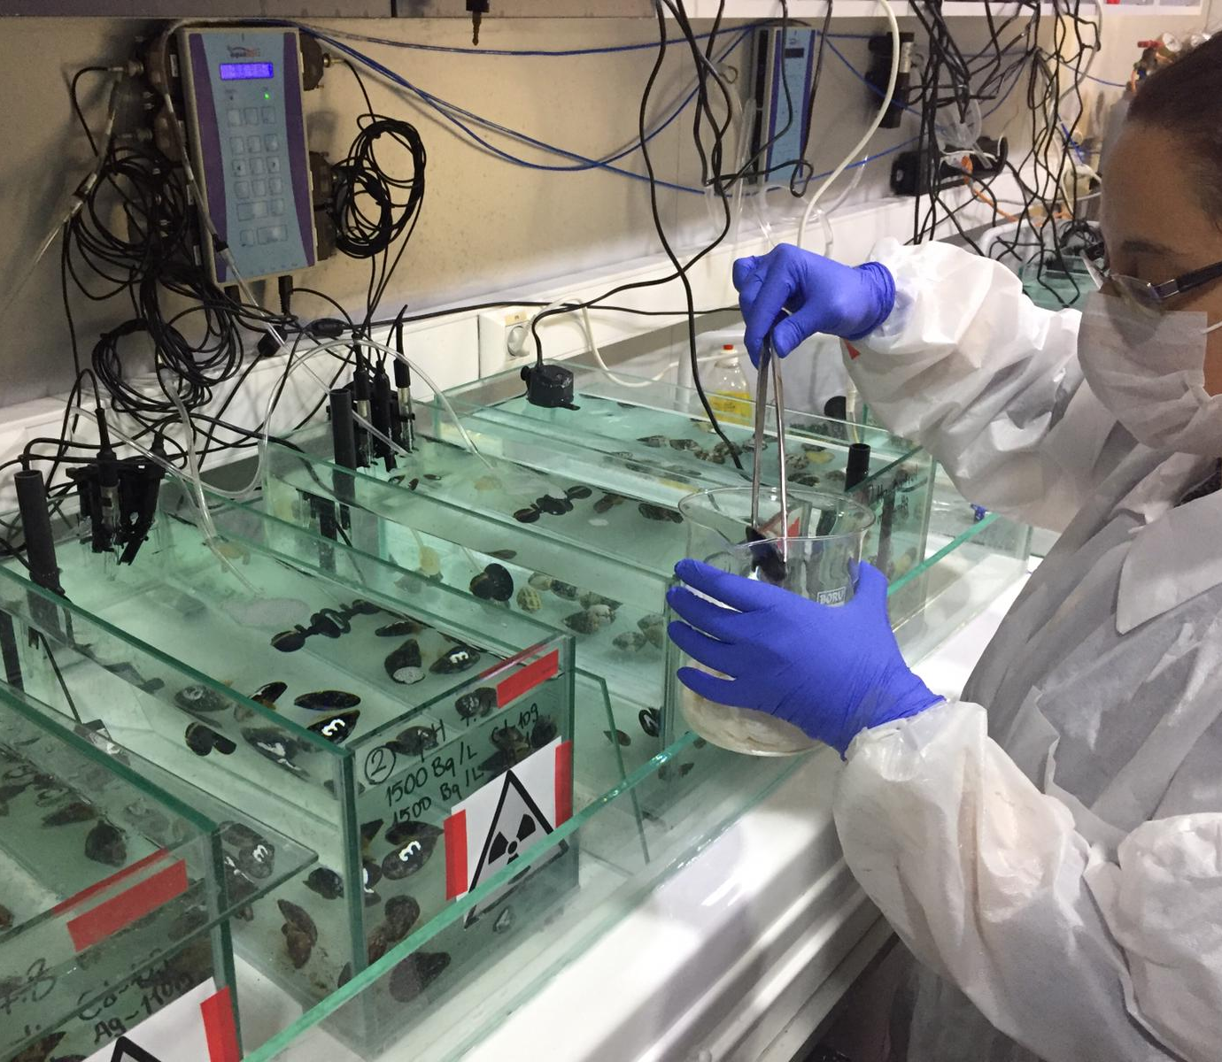
What is our goal?
Create a model with improved accuracy that predicts the age of abalone
Simplify and shorten the long, tedious process to discover the age of abalone.
Information proves valuable to researchers and consumers

Slide 3
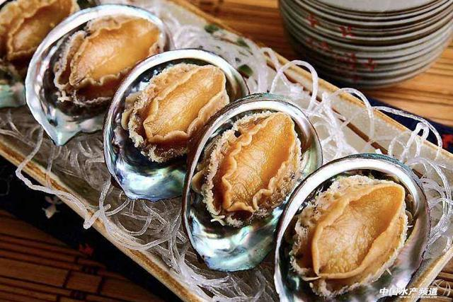




Approach
Data
Initial Analysis
Evaluating Previous Work
Comparison of Different Models
Conclusions

Slide 4
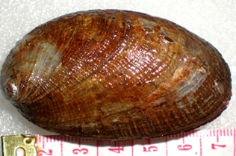
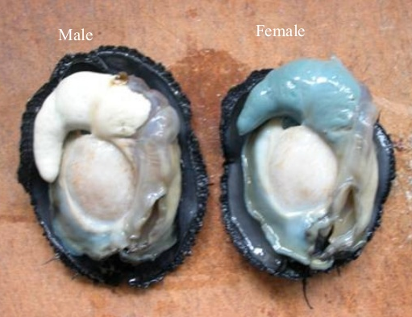
Abalone Dataset
Male | Female | Intersex | Length | Diameter | Height | WholeWeight | ShuckedWeight | VisceraWeight | ShellWeight | Rings
1 | 0 | 0 | 0.455 | 0.365 | 0.095 | 0.514 | 0.2245 | 0.101 | 0.15 | 15
1 | 0 | 0 | 0.35 | 0.265 | 0.09 | 0.2255 | 0.0995 | 0.0485 | 0.07 | 7
0 | 1 | 0 | 0.53 | 0.42 | 0.135 | 0.677 | 0.2565 | 0.1415 | 0.21 | 9
1 | 0 | 0 | 0.44 | 0.365 | 0.125 | 0.516 | 0.2155 | 0.114 | 0.155 | 10
0 | 0 | 1 | 0.33 | 0.255 | 0.08 | 0.205 | 0.0895 | 0.0395 | 0.055 | 7
Sex | Length | Diameter | Height | WholeWeight | ShuckedWeight | VisceraWeight | ShellWeight | Rings
M | 0.455 | 0.365 | 0.095 | 0.514 | 0.2245 | 0.101 | 0.15 | 15
M | 0.35 | 0.265 | 0.09 | 0.2255 | 0.0995 | 0.0485 | 0.07 | 7
F | 0.53 | 0.42 | 0.135 | 0.677 | 0.2565 | 0.1415 | 0.21 | 9
M | 0.44 | 0.365 | 0.125 | 0.516 | 0.2155 | 0.114 | 0.155 | 10
I | 0.33 | 0.255 | 0.08 | 0.205 | 0.0895 | 0.0395 | 0.055 | 7

Slide 5
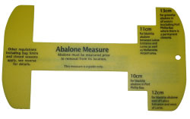
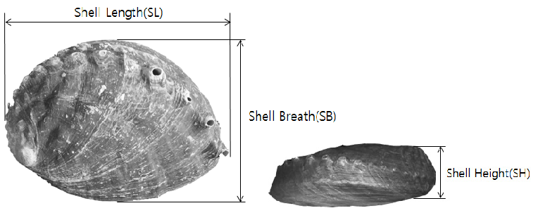
Data
Sex
Description: M (Male), F (Female), I (Immature)
Used binary coding to define Sex (1, 0)
Data Type: Nominal
Length
Measurement Tool for Abalone
Description: Longest shell measurement in mm
Data Type: Continuous
Statistics: Min-0.075, Max- 0.815, Mean- 0.524, SD- 0.120
Diameter
Description: Longest shell measurement perpendicular to length in mm
Data Type: Continuous
Statistics: Min-0.055, Max- 0.650, Mean- 0.408, SD- 0.099
Height
Description: Measurement of height with meat in shell in mm
Data Type: Continuous
Statistics: Min-0.000, Max- 1.130 , Mean- 0.140, SD- 0.490
Whole Weight
Diagram Displaying Length (SL), Diameter (SB) and Height (SH) of an Abalone
Description: Weight of entire abalone in grams
Data Type: Continuous
Statistics: Min-0.002, Max- 2.826, Mean- 0.829, SD- 0.490

Slide 6
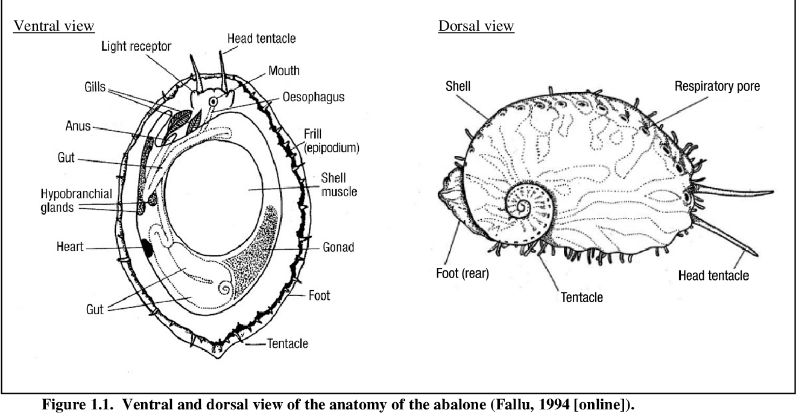
Data
Whole Weight
Description: Weight of abalone meat in grams
Data Type: Continuous
Statistics: Min-0.001, Max- 1.488, Mean- 0.359, SD- 0.222
Viscera Weight
Description: Gut weight of abalone (after bleeding) in grams
Data Type: Continuous
Statistics: Min-0.001, Max- 0.760, Mean- 0.181, SD- 0.110
Shell Weight
Description: Weight of abalone shell after being dried in grams
Data Type: Continuous
Statistics: Min-0.002, Max- 1.005, Mean- 0.239, SD- 0.139
Rings
Description: Number of rings in an abalone shell. The age is determined to be the number of rings+1.5.
Data Type: Integer
Statistics: Min-1, Max- 29, Mean- 9.934, SD- 3.224

Slide 7
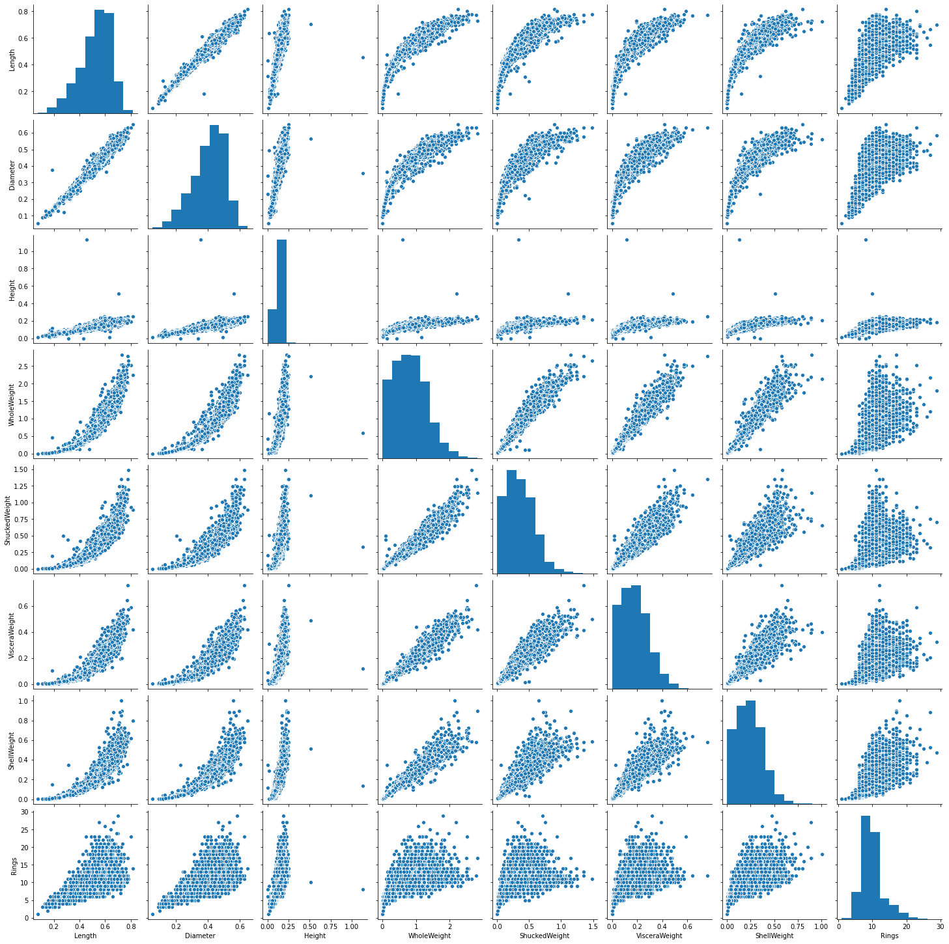
Pair Plot
Gender omitted
Diagonal displays histograms of data points in data set
Other plots display correlation between two variables
All interaction between variables display positive correlation
Number of rings is positively correlated with each variable, indicative of

Slide 8
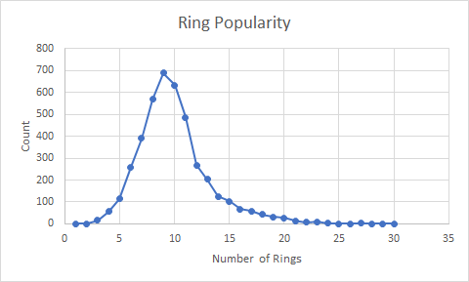
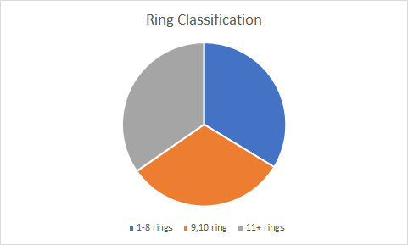
Data Classification

Slide 9
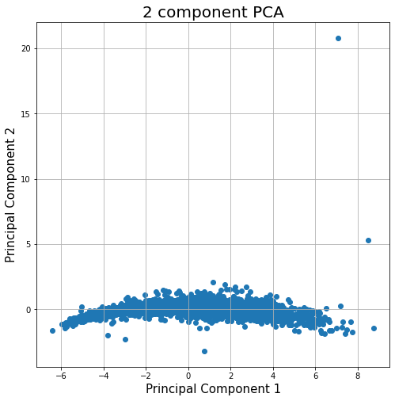
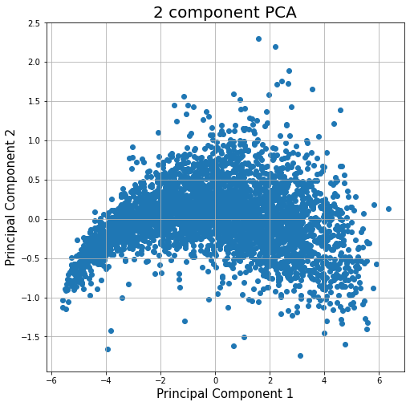
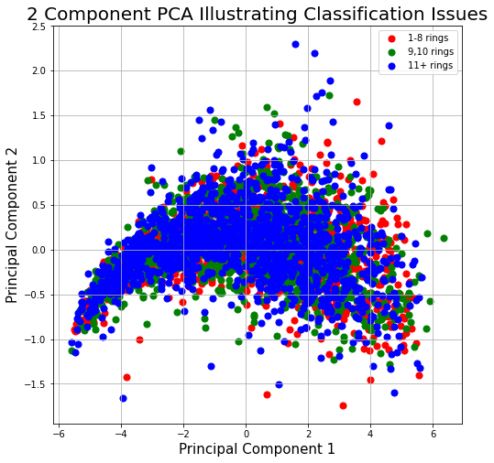
Closer Look at Dataset Using PCA

Slide 10
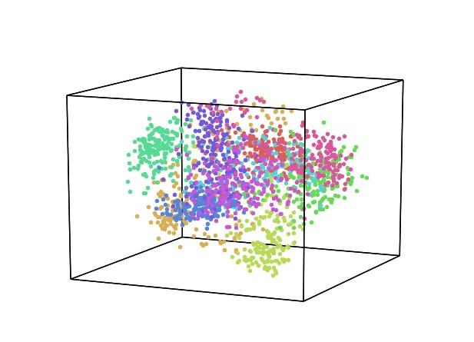
Previous Work on Abalone Data
Approach
Classification
Idea
Extending and Benchmarking Cascade-Correlation
Author(s)
Sam Waugh
Test Set Performance
3133 training, 1044 testing
24.86% Cascade-Correlation (no hidden nodes)
26.25% Cascade-Correlation (5 hidden nodes)
21.5% C4.5
0.0% Linear Discriminate Analysis
3.57% k=5 Nearest Neighbor
Data set samples are highly overlapped.
Visualization not representative of data
Notes:
Further information is required to separate completely using affine combinations. Other restrictions to data set examined.

Slide 11
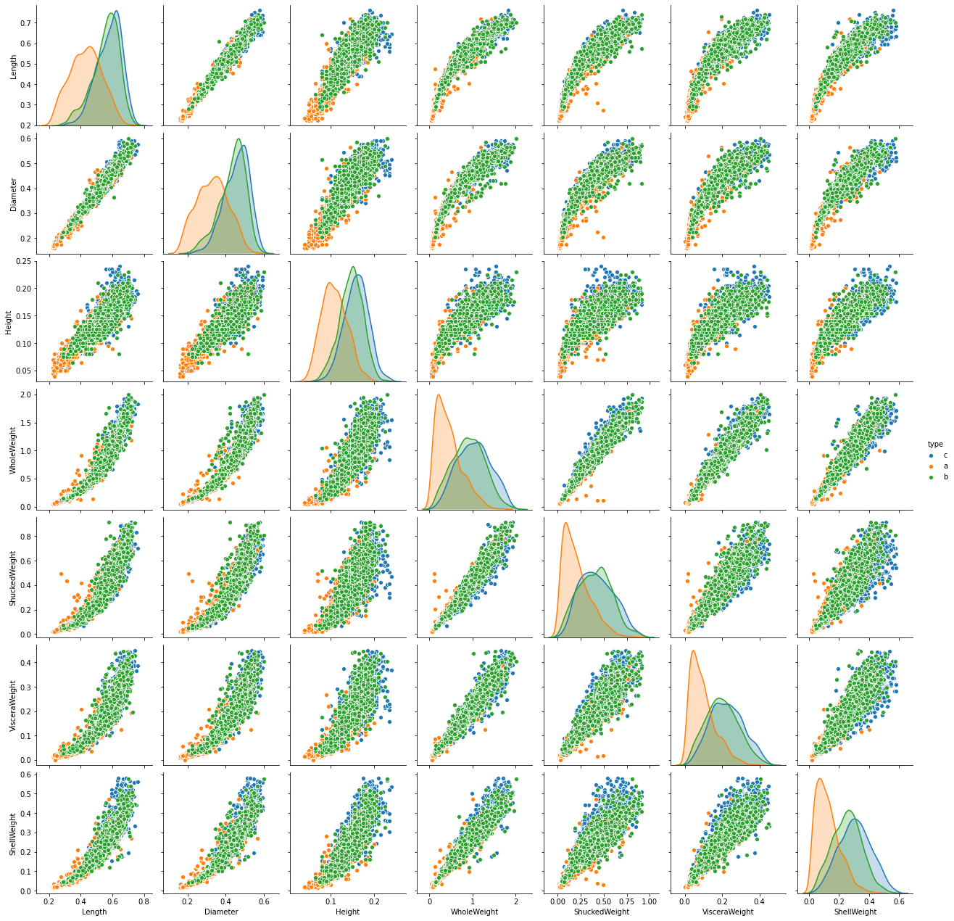
Previous Work on Abalone Data
Approach
Grouped Classification
Group 1: ring classes 1-8
Group 2: ring classes 9 and 10
Group 3: ring classes 11+
Idea
Comparing Dystal and Backpropagation
Author(s)
David Clark, Zoltan Schreter, Anthony Adams
Test Set Performance
3133 training, 1044 testing
64% Backprop
55% Dystal
61.40% Cascade-Correlation (no hidden nodes)
65.61% Cascade-Correlation (5 hidden nodes)
59.2% C4.5
32.57% Linear Discriminant Analysis
62.46% k=5 Nearest Neighbour
Orange = 1-8 rings
Green = 9,10 rings
Blue = 11+ rings

Slide 12
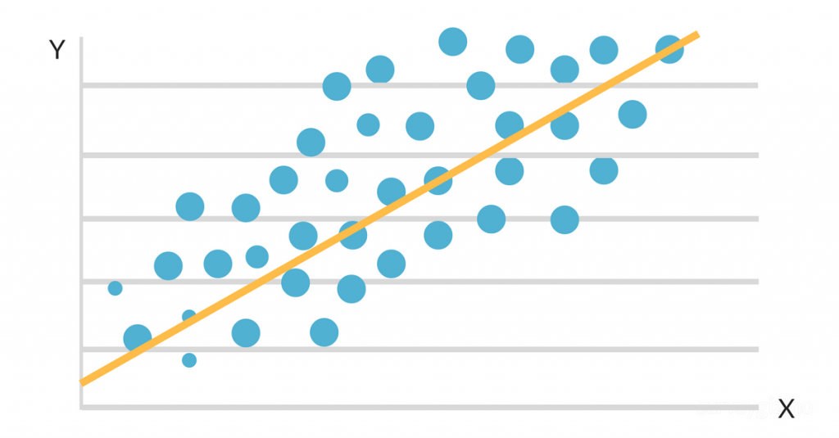
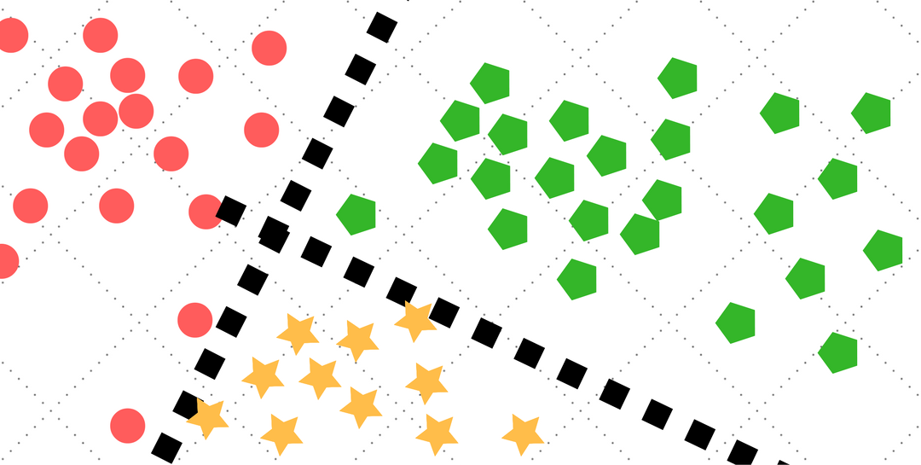
General Approach
Regression
Treat the number of rings as a continuous variable
Classification by Number of Rings
Treat the number of rings as a discrete variable
Each number is defined as a specific class
Classification by Grouped Number of Rings
Group the number of rings into three categories
Predict the group assignments

Slide 13
Models Used
Regression
Classification
Lasso Regression
Random Forest Classifier
Ridge Regression
Multi-layer Perceptron Classifier
Random Forest Regressor
Multi-layer Perceptron regressor
Support Vector Classifier
Support Vector Regressor

Slide 14
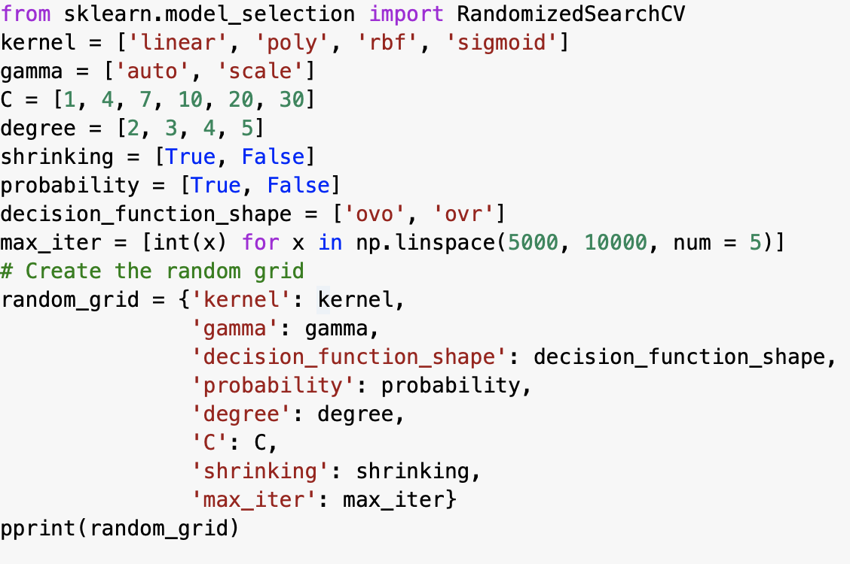
Fine-Tuning
Random Search over possible parameters
K-fold Cross Validation, k = 5 | number of iterations = 200

Slide 15
Results
 | Regression (metrics = R^2) | Classification (metrics = accuracy) | Grouped Classification (metrics = accuracy)
Random Forest | 0.567 vs 0.502 | 0.278 vs 0.244 | 0.641 vs 0.482
Linear - Lasso | 0.519 vs 0.301 | - | -
Linear - Ridge | 0.518 vs 0.514 | - | -
MLP | 0.575 vs 0.560 | 0.282 vs 0.265 | 0.662 vs 0.655
SVC | 0.551 vs 0.488 | 0.266 vs 0.256 | 0.626 vs 0.617
Best Previous | - | 0.263 | 0.656

Slide 16
Conclusion
Exhibited multiple models that performed better than previous attempts
MLP with proper fine-tuning performs better than other models
Fine-tuning improves the models’ performance
grid search may improve the result further
Linear regression is not performing as well as other models
possibly because certain assumptions for linear regression is not satisfied by the data set

Slide 17
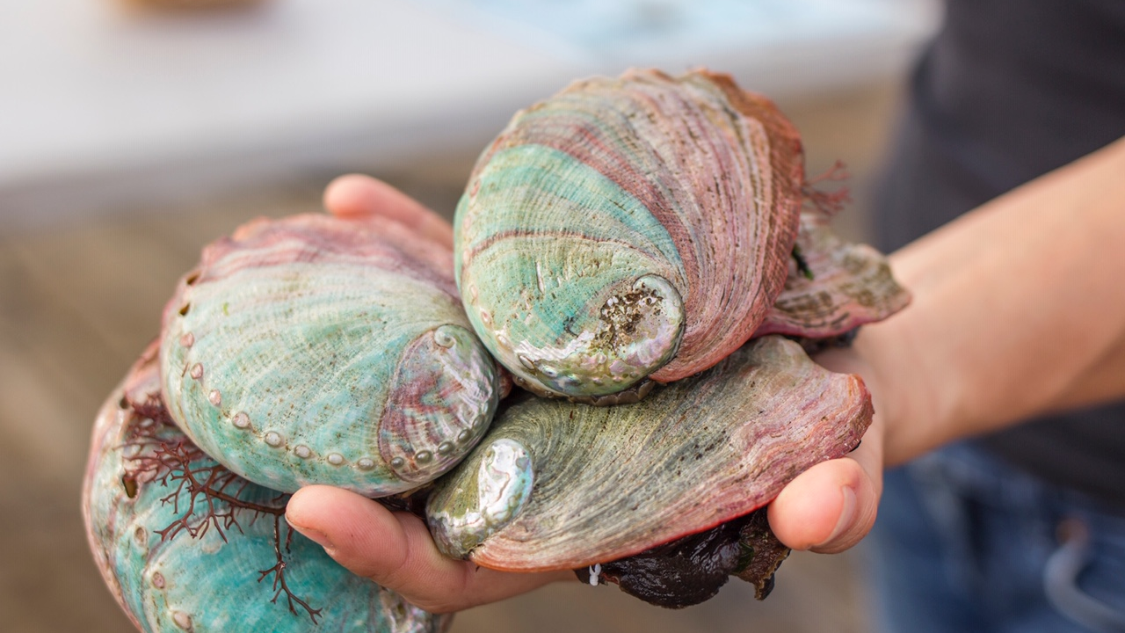
Thank You

